Slide 1
JAVA ARCHITECTUTE Part-1
Presenter: Davoud Badamchi
Presentation Date: 7/28/2019 10:00 am

Slide 2
Challenges and opportunities of network Continued on next page.
Wide range of hardware devices that network interconnect.
Different devices with different hardware, software and purpose.
JAVA overcome this challenge by being platform-independent.
Platform-independent
A program written in JAVA can run on every device and platform.
Programs are cheaper and easier to develop, administer and maintain.

Slide 3
Challenges and opportunities of network Continued on next page.
Second challenge of network for developers is security.
Network is an avenue for malicious programmers to steal and destroy information.
JAVA addresses this challenge by providing environment in which downloaded programs can be run safely. how?
JAVA is type-safe. Why?
automatic memory management, garbage collection, and range-checking on arrays; which throws an exception called?

Slide 4
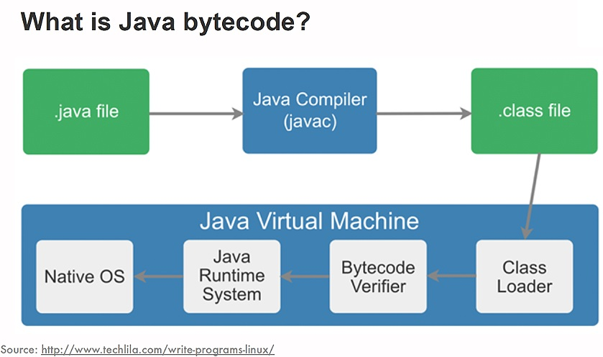
Challenges and opportunities of network Continued on next page.

Slide 5
Challenges and opportunities of network Continued on next page.
Compiler translates Java programs into a machine-independent bytecode.
A bytecode verifier is invoked to ensure that only legitimate bytecodes are executed at runtime.
Verifier checks that bytecode conform to JAVA language specifications and do not violate JAVA language rules or namespace restrictions.
Verifier also checks for memory management violations, stack underflows or overflows and illegal data typecasts.
Once bytecode have been verified JAVA runtime prepare it for execution.
Access modifiers which can be assigned to classes, methods, fields which allow developers to restrict access to their class implementation. (public, private, package-private, protected)

Slide 6
Challenges and opportunities of network Continued on next page.
One opportunity created by network is online software distribution.
Enables the transmission of binary code throughout the network.
Easier and cheaper to deliver
It simplifies version control.
Needless to worry about end-user’s code
When they want to run they will get the most recent code
Mobile objects (RMI)

Slide 7
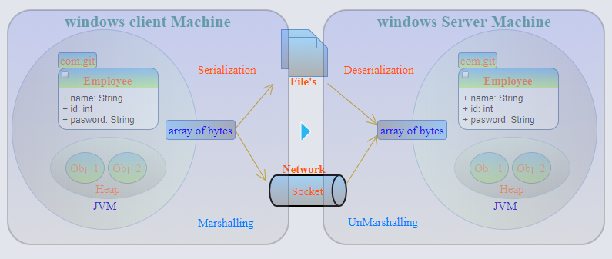
Challenges and opportunities of network Continued on next page.

Slide 8
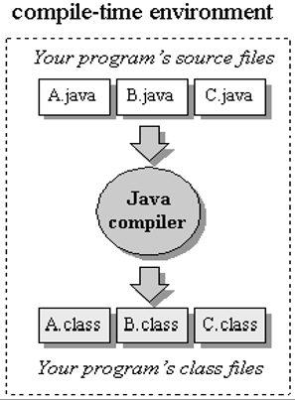
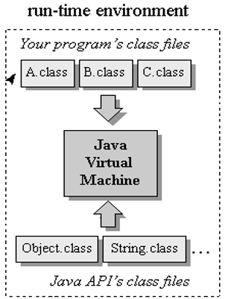
JAVA Architecture Continued on next page.
the Java programming language
the Java Application Programming Interface
the Java class file format
the Java virtual machine
Locally
Remotely

Slide 9
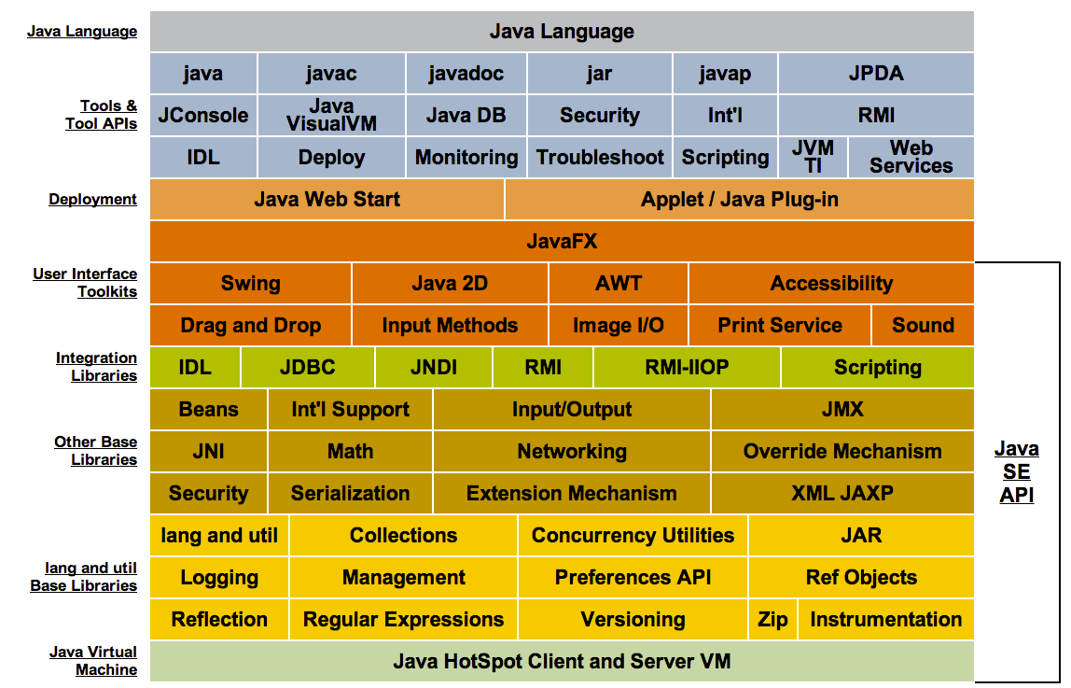
JAVA Architecture Continued on next page.

Slide 10
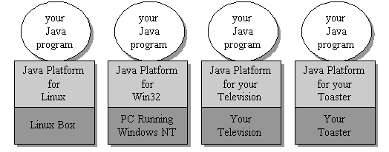
JAVA Architecture
What is JAVA platform?
The combination of the Java virtual machine and Java API is called the Java Platform
Java programs run on top of the Java Platform

Slide 11
JAVA virtual machine (JVM)
JVM supports all three JAVA’s network-oriented architecture
Platform independence
Security
Network-mobility
JVM is an abstract computer
JVM is flexible, it can be implemented in software or varying hardware.
JVM’s main purpose is to load class files and execute the bytecode they contains.

Slide 12
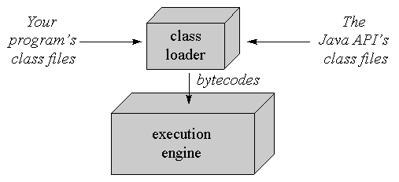
JVM’s Class loader
JVM’s class loader loads the classes from program and Java API
Only Java APIs that are needed to run the program are loaded.
Bytecodes run in execution engine.

Slide 13
JVM’s Execution engine
There are different implementation of execution engine.
simplest form of execution engine just interprets the bytecodes one at a time
Faster but requires more memory, is a just-in-time compiler
Adaptive optimizer, optimizes the heavily used part of the code again and again to increase execution time.
What is Java interpreter? What is Java compiler?
All Java interpreters are Java Virtual machine but All JVMs are not Java interpreters.

Slide 14
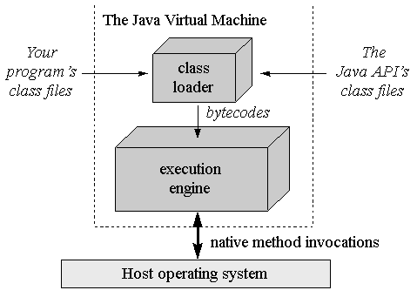
Native methods and JNI
Java program interacts with host by invoking native methods.

Slide 15
Thanks

